Slide 1
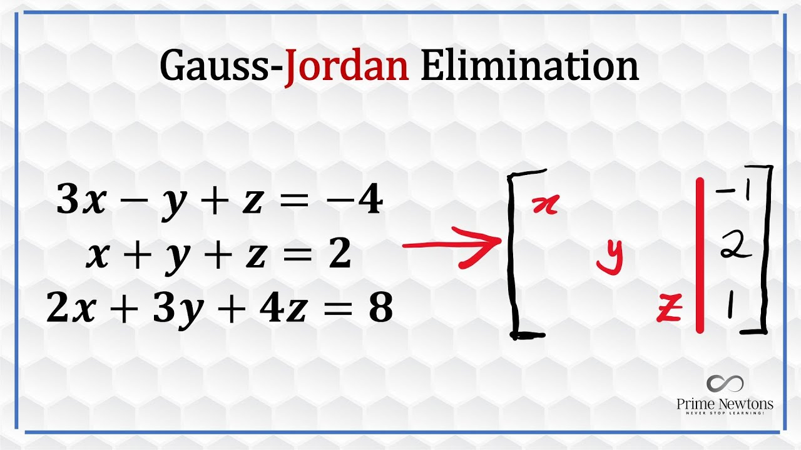
Gauss-Jordan Elimination
-Prakrititz Borah (IMT2023547)
Algorithmic Thinking
13th February 2026
Image Src: Prime Newtons @Youtube

Slide 2
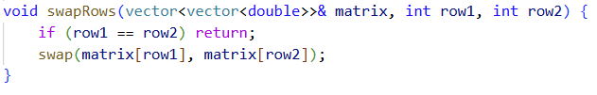
Code: https://github.com/prakrititz/Gauss-Jordan-Cpp

Slide 3
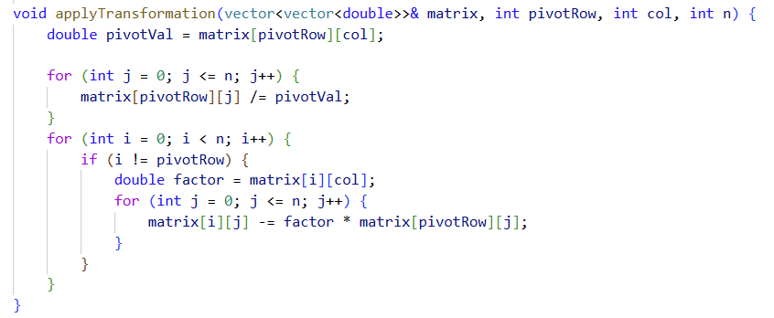
Code: https://github.com/prakrititz/Gauss-Jordan-Cpp

Slide 4
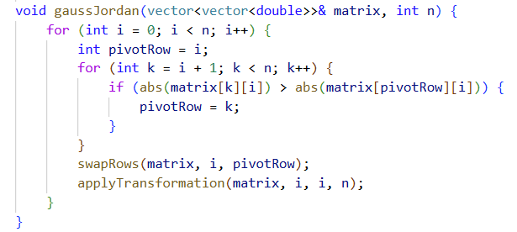
Code: https://github.com/prakrititz/Gauss-Jordan-Cpp

Slide 5
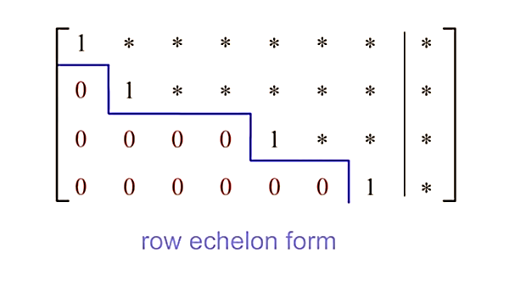
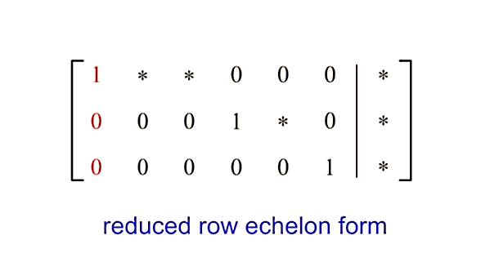
Can we make it for general NxM?
Main Goal : Reduced Row Echelon Form (RREF).
Code: https://github.com/prakrititz/Gauss-Jordan-Cpp

Slide 6
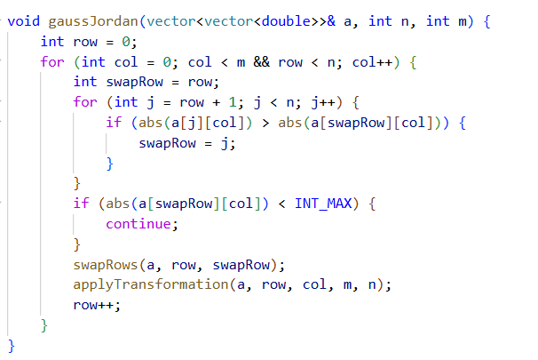
Code: https://github.com/prakrititz/Gauss-Jordan-Cpp

Slide 7
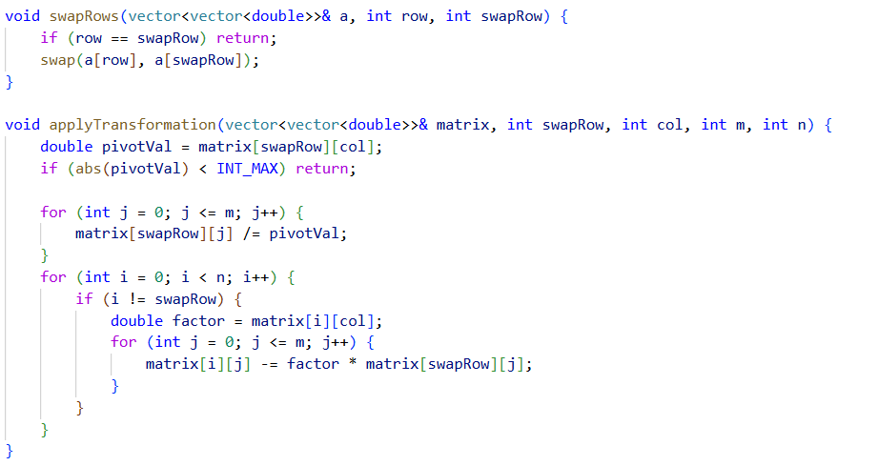
Code: https://github.com/prakrititz/Gauss-Jordan-Cpp

Slide 8
Complexity?

Slide 9
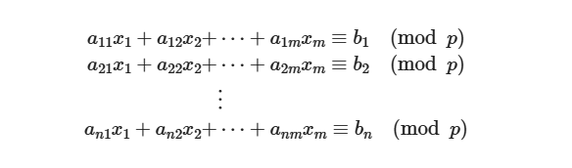
The code discussed we would deal more in ML, as we often deal with floating-point approximations.
In CP, we prioritize exact solutions using Modular Arithmetic.

Slide 10
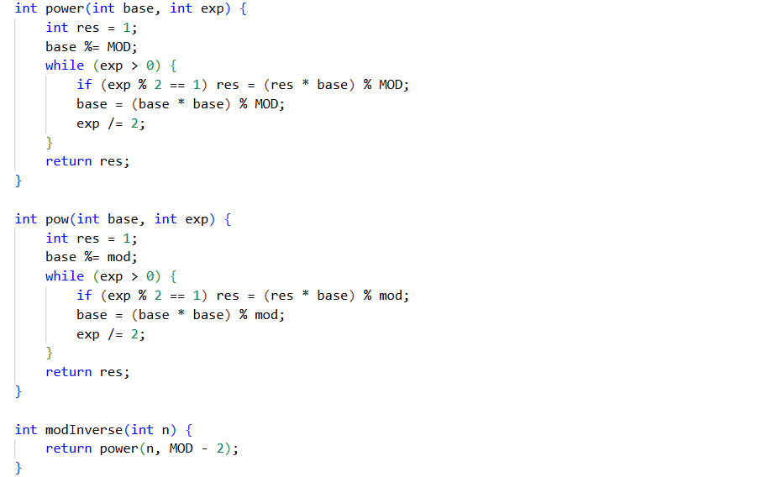
Code: https://github.com/prakrititz/Gauss-Jordan-Cpp

Slide 11
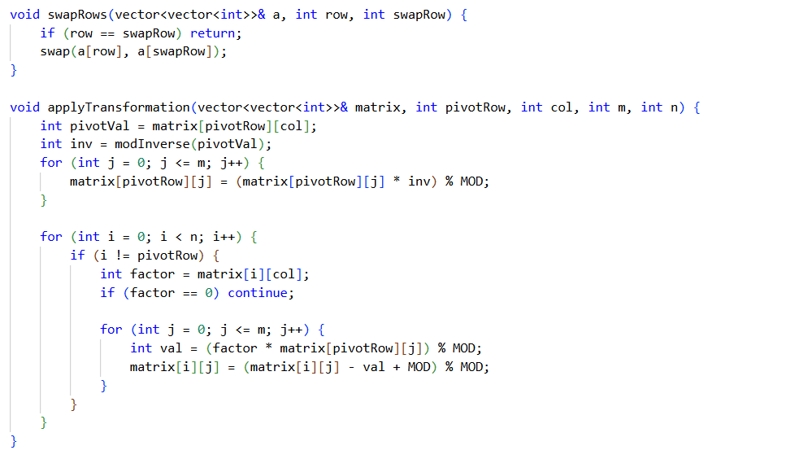
Code: https://github.com/prakrititz/Gauss-Jordan-Cpp

Slide 12
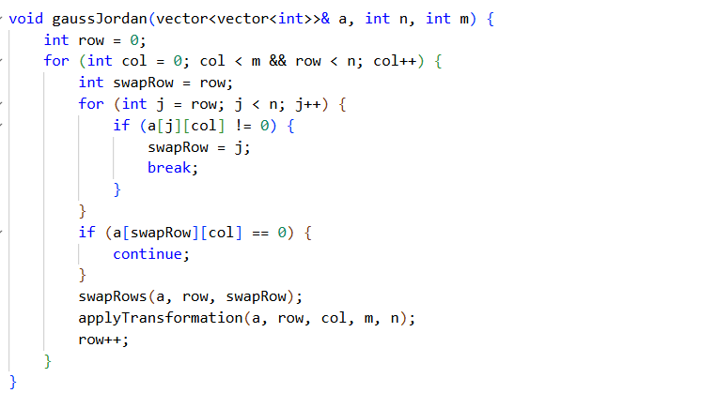
Code: https://github.com/prakrititz/Gauss-Jordan-Cpp

Slide 13
The XOR Trick

Slide 14
Codeforces 895C https://codeforces.com/problemset/problem/895/C
For some array a find the number of different ways to select non-empty subset of elements from it in such a way that their product is equal to a square of some integer.
Two ways are considered different if sets of indexes of elements chosen by these ways are different.
find the answer modulo 10⁹ + 7.
Input
First line contains one integer n (1 ≤ n ≤ 10⁵)
Second line contains n integers a_{i} (1 ≤ a_{i} ≤ 70)
Output
Print one integer — the number of different ways to choose some elements so that their product is a square of a certain integer modulo 10⁹ + 7.
Examples
Input
4
1 1 1 1
Output
15
Input
4
2 2 2 2
Output
7
Input
5
1 2 4 5 8
Output
7
Note
In first sample product of elements chosen by any way is 1 and 1 = 1². So the answer is 2⁴ - 1 = 15.
In second sample there are six different ways to choose elements so that their product is 4, and only one way so that their product is 16. So the answer is 6 + 1 = 7.

Slide 15
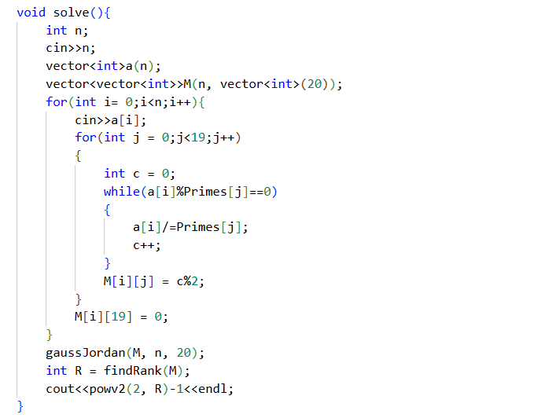
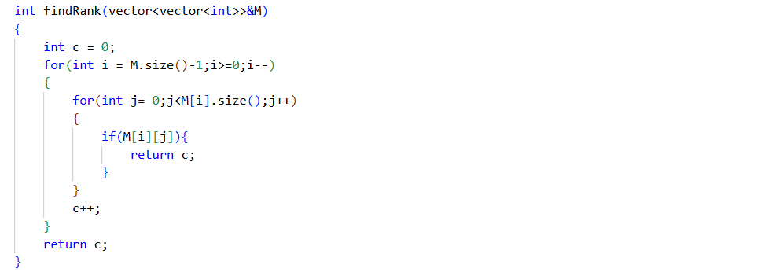
Code: https://github.com/prakrititz/Gauss-Jordan-Cpp

Slide 16
https://codeforces.com/problemset/problem/959/F
Problem: Prefix XOR Subsequence Counting
Given:
An array n integers n integers a₁, a₂, ..., a_{n} (0 ≤ a_{i} < 2²⁰)
q queries, each contains integers l and x (1 ≤ l ≤ n, 0 ≤ x < 2²⁰),
Task:
For each query find the number of subsequence of the first l elements of the array such that their bitwise-xor sum is exactly x.
Constraints:
Output the answer for each query modulo 10⁹ + 7
Key Property:
The bitwise-xor sum of the empty set is 0 and the bitwise-xor sum of a set containing one element is that element itself.

Slide 17
Only one query N, X

Slide 18
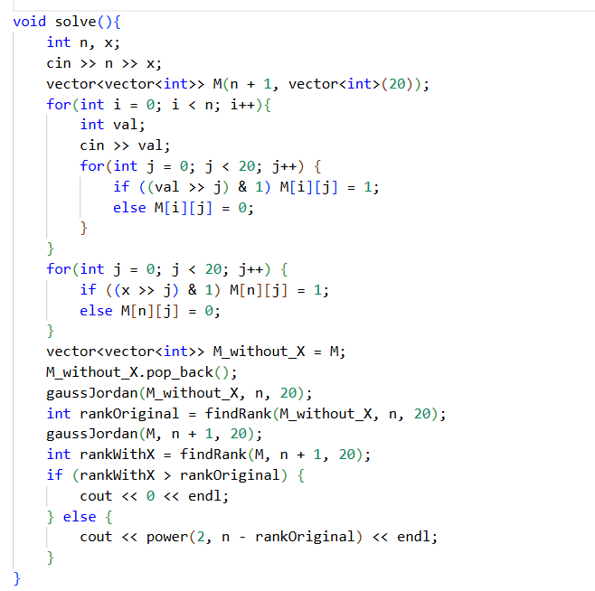
Code: https://github.com/prakrititz/Gauss-Jordan-Cpp

Slide 19
How To Deal With Multiple Query?
Hint: We only need to care about the Rank until ith index

